Slide 1
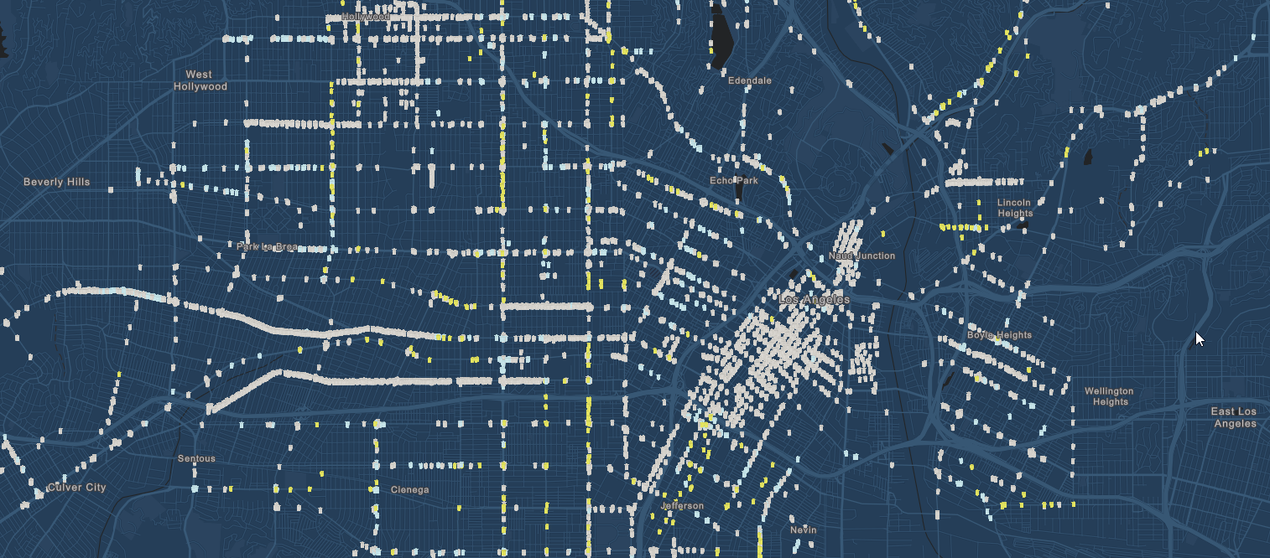
Violent Crime Trends in Los Angeles, CA
Los Angeles, CA
From 2010 to 2018.
J. Heston, S. Saha, E. Trittipo.

